Slide 1
Introduction to Data Bases
NAFTI ABBOUD

Slide 2
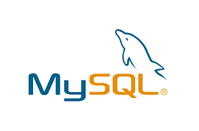
What is MySQL ?
MySQL is a relational database management system. This database language is based on the SQL queries to access and manage the records of the table.
MySQL consists of a strong data security layer that protects sensitive data from intruders. In addition, passwords are encrypted in MySQL.
MySQL is considered to be one of the very fast database languages, backed by a large number of benchmark tests.
Its efficiency is high because it has very low memory leak problem.
MySQL uses triggers, stored procedures and views that allow the developer to increase his productivity.
MySQL does not support SQL check constraints.

Slide 3

What is PostgreSQL
PostgreSQL is a popular relational database management system (RDBMS).
It is the first DBMS, which runs MVCC [Multi-Version Concurrency Control] functionality, even before Oracle.
It is written in the C programming language.
PostgreSQL is the existing database for the macOS server.
PostgreSQL is cross-platform and works on various operating systems such as Microsoft Windows, UNIX, FreeBSD, Mac OS X, Solaris, HP-UX, LINUX, etc.
Its source code is available under the PostgreSQL license; thus, we can use it freely, modify and allocate PostgreSQL in any form.

Slide 4
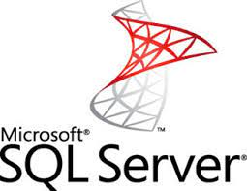
What is SQL server
SQL Server is software (A Relational Database Management System) developed by Microsoft. It is also called MS SQL Server. It is implemented from the RDBMS specification.
The Relational Database Management System (RDBMS) is a Microsoft software product primarily used to store and retrieve data for the same or other applications.
MS SQL Server, which is an ORDBMS, platform dependent, and can run on GUI and command based software.
MS SQL Server, which is an ORDBMS, platform dependent, and can run on GUI and command based software.

Slide 5
comparison between the three RDBMS :
MySQL | PostgreSQL | SQL Server
Initial release was in 1995 | Initial release was in 1989 | Initial release was in 1989
Written in C, has a few C++ modules | Witten in C | Mostly C++ with a few exceptions
Open source / Owned by Oracle and has several paid editions | Completely free / Open source | Licenced
MySQL will usually use 1 CPU per query. | Query plans can leverage multiple CPUs | Query plans can leverage multiple CPUs
Multi-column indexes can have up to 16 columns | Multi-column indexes can have up to 32 columns | Multi-column indexes can have up to 16 columns

Slide 6
